Slide 1
The Interpreter Pattern (Behavioral)

Slide 2
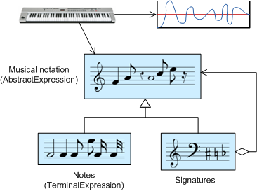
Intent
Given a language, define a representation for its grammar along with an interpreter that uses the representation to interpret “sentences” in the language.

Slide 3
Motivation
If a particular problem occurs often enough, then it might be worthwhile to express instances of that problem as “sentences” (programs) in a simple language. Then you can build an interpreter that solves the problem by interpreting these sentences.
The Interpreter pattern describes how to
define a grammar for simple languages.
represent sentences in the language using abstract syntax trees.
interpret these sentences.

Slide 4
Motivation (contd.)
For example, searching for strings that match a pattern is a common problem.
Regular expressions are a standard language for specifying patterns of strings.
Rather than building custom algorithms to match each pattern against strings, search algorithms could interpret a regular expression that specifies a set of strings to match.

Slide 5
Motivation (contd.)
In this example, the pattern describes how to:
define a grammar for regular expressions,
represent a particular regular expression,
and how to interpret that regular expression.

Slide 6
Motivation (contd.)
Suppose the following grammar defines the regular expressions:
expression ::= literal | alternation | sequence | repetition | '(' expression ')'
alternation ::= expression '|' expression
sequence ::= expression '&' expression
repetition ::= expression '*'
literal ::= 'a' | 'b' | 'c' | ... { 'a' | 'b' | 'c' | ... }*

Slide 7
Motivation (contd.)
The Interpreter pattern uses a class to represent each grammar rule.
Symbols on the right-hand side of the rule are instance variables of these classes.
The grammar above is represented by five classes:
an abstract class RegularExpression and its four subclasses
LiteralExpression,
AlternationExpression,
SequenceExpression,
and RepetitionExpression.
The last three classes define variables that hold subexpressions.

Slide 8
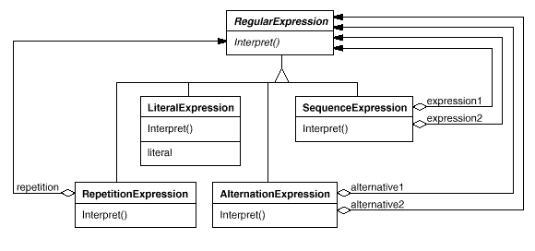
Motivation (contd.)

Slide 9
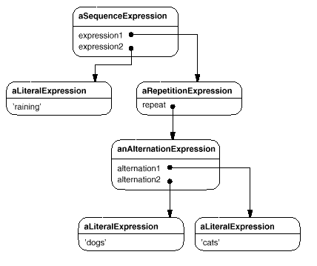
Motivation (contd.)
Every regular expression defined by this grammar is represented by an abstract syntax tree made up of instances of these classes. For example, the following abstract syntax tree represents the regular expression
raining & (dogs | cats) *

Slide 10
Motivation (contd.)
We can create an interpreter for these regular expressions by defining the Interpret () operation on each subclass of RegularExpression.
Interpret takes as an argument the context in which to interpret the expression.
The context contains the input string and information on how much of it has been matched so far.
Each subclass of RegularExpression implements Interpret to match the next part of the input string based on the current context. For example:
LiteralExpression will check if the input matches the literal it defines,
AlternationExpression will check if the input matches any of its alternatives,
RepetitionExpression will check if the input has multiple copies of expression it repeats.

Slide 11
Interpreter Pattern Applicability
The Interpreter pattern works best when
the grammar for the language being interpreted is simple.
efficiency of the interpreter is not a critical concern. If efficiency is a concern, consider implementing a compiler, which uses similar techniques.

Slide 12
Interpreter Pattern (continued)
Structure
Context
Client
AbstractExpression
interpret(Context)
*
TerminalExpression
interpret(Context)
NonterminalExpression
interpret(Context)
1

Slide 13
Interpreter Pattern Participants
AbstractExpression
declares an abstract interpret() operation that is common to all nodes in the abstract syntax tree.
NonterminalExpression
one such class is required for every rule in the grammar.
maintains instance variables corresponding to the symbols on the right-hand side of the rule.
implements an interpret operation for the nonterminal symbol on the left-hand side of the rule (typically by using recursion).

Slide 14
Interpreter Pattern Participants (continued)
TerminalExpression
implements an interpret() operation associated with the terminal symbols in the grammar.
an instance is required for every terminal symbol in a program.
Context
contains information that is global to the interpreter.
Client
builds an abstract syntax tree for a program.
invokes the interpret operation.

Slide 15
Interpreter Pattern Collaborations
The Client
builds an abstract syntax tree of NonterminalExpression and TerminalExpression instances.
initializes the context.
invokes the interpret() operation.
Each NonterminalExpression node defines interpret() in terms of interpret() on each subexpression.
The interpret() operation of each TerminalExpression defines the base case in the recursion.
The interpret() operations at each node use the context to store and access the state of the interpreter.

Slide 16
Interpreter Pattern Consequences
The Interpreter pattern has the following benefits and liabilities:
It’s easy to change and extend the grammar. Since the pattern uses classes to represent grammar rules, you can use inheritance to change or extend the grammar.
Implementing the grammar is straightforward. Classes defining nodes in the abstract syntax tree are relatively straightforward to implement. Automated tools (parser generators) can often be used to generate the classes automatically.

Slide 17
Interpreter Pattern Consequences (continued)
Complex grammars are hard to maintain. The Interpreter pattern defines roughly one class for every rule in the grammar. Grammars containing many rules can make the interpreter hard to maintain. Parser generators can help in this case.
The Interpreter pattern makes it easy to evaluate an expression in a new way. For example, it is easy to add type-checking or pretty printing to a language by defining a new operation on the expression classes. (See, also, the Visitor pattern.)

Slide 18
Interpreter Pattern Implementation
Creating the abstract syntax tree. Not defined by the interpreter pattern. The abstract syntax tree can be created by any one of several parsing techniques (table-driven, recursive descent, etc.)
Defining the interpret() operation. If it is common to create a new interpreter, then it might be better to use the Visitor pattern than to define an interpret() operation in the expression classes.
Sharing terminal symbols with the Flyweight pattern. Grammars whose sentences contain many occurrences of a terminal symbol might benefit from sharing a single copy of that symbols.

Slide 19
Related Patterns
The abstract syntax tree is an instance of the Composite pattern.
The interpreter can use an Iterator to traverse the structure.
Visitor can be used to maintain the behavior in each node of the abstract syntax tree in one class.

Slide 20
References
Interpreter pattern (Wikipedia)
http://en.wikipedia.org/wiki/Interpreter_pattern
Interpreter Design Pattern (SourceMaking)
http://sourcemaking.com/design_patterns/interpreter
Interpreter Design Pattern (BlackWasp)
http://www.blackwasp.co.uk/Interpreter.aspx
Domain-Specific Languages: An Introductory Example (by Martin Fowler)
http://www.informit.com/articles/article.aspx?p=1592379

